Slide 1

Address Enrichment and Classification

Slide 2



Issues
Is the address provided by the individual is really correct?
Is the home address provided is commercial area ?
Verification of addresses by investigators manually

Slide 3



Address Data Enrichment
Data Collection
Data Cleaning
Data Enhancement

Slide 4





Data Collection
Halifax Open Data
http://catalogue-hrm.opendata.arcgis.com/
Building Data
HRM Parks Data
Hospital Data Civic Address

Slide 5




Data Cleaning & Enhancement
Null Value
Filter Data
Residential
Classifying Data
Non Residential

Slide 6
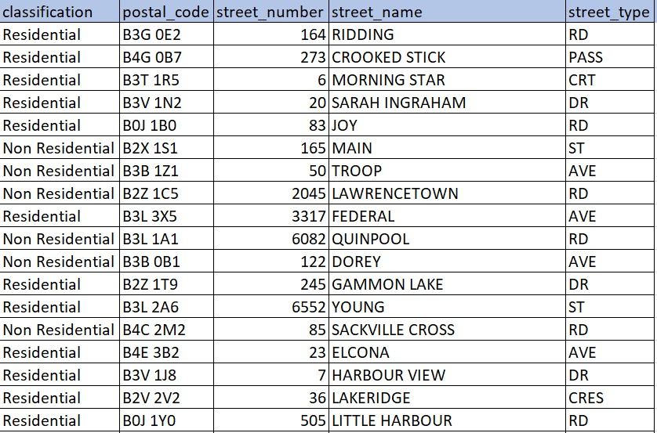
Final Dataset
Dependent Variable-Classification
Independent Variables-
Postal_Code, Street_Number,
Street_Name, Street_Type

Slide 7

Address Data Integrity
Identify
Search
Exhibit

Slide 8


Address Validation Verticals
Text Classification
Web results classification

Slide 9

User Interaction Platform
Multiple Platform Access
Functionality improvement
Cost Reduction
Time Saving

Slide 10
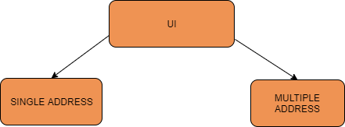
Functionality

Slide 11
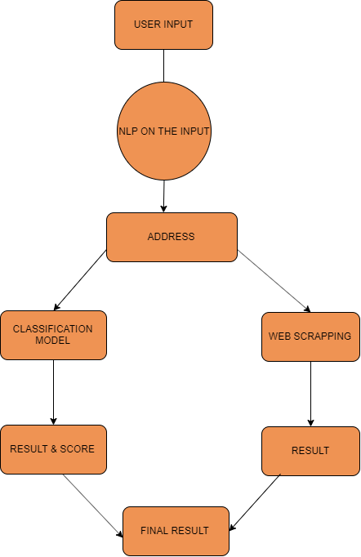
Flow Diagram

Slide 12
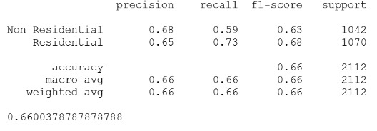
Textual Classification
Supervised Learning
Random Forest Algorithm

Slide 13
Web Results Classification
Counts of top 10 occurring keywords
Keywords are used to identify if the address is Residential or Non-Residential

Slide 14
Improvements
Chatbot integration
Batch processing
street images
Classification

Slide 15
Pros
Verification of result from two layers
Result independent of different verticals
Understands input address in any form
Multiple Platforms

Slide 16


COST
Free as of now
Maps API: CA$ 9 per 1000 requests
AWS Server: CA$ 48
Database: CA$ 57

Slide 17
Cons
Longer time for Batch processing
Limited number of requests per day (Free Api’s)

Slide 18
Future Work
Efficient batch processing
Results can be e-mailed
Image classification can improve the accuracy

Slide 19
Future Work
Feedback Mechanism
Self training

Slide 20
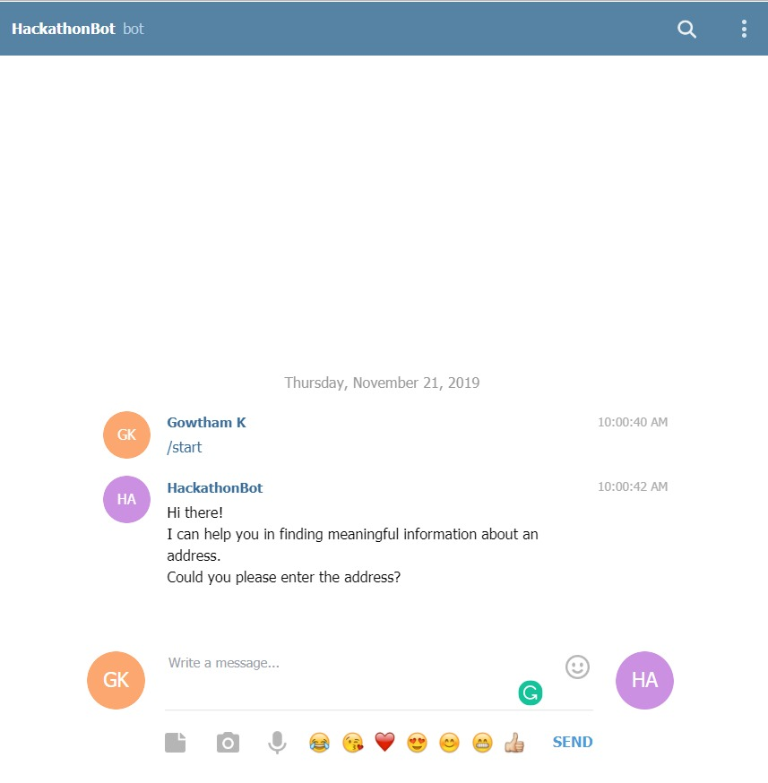

`
BOT URL

Slide 21


Thank You

